Slide 1

FORGEQA WORKING SESSION
01 / 12
From AI Test Generation to QA Execution
Client Q&A translated into product positioning, engineering priorities, and a release-ready testing workflow.
Build the system—not just the prompt.
A product strategy session for turning ForgeQA into the daily operating layer for quality teams.
Developer + QA Team | August 2026

Slide 2
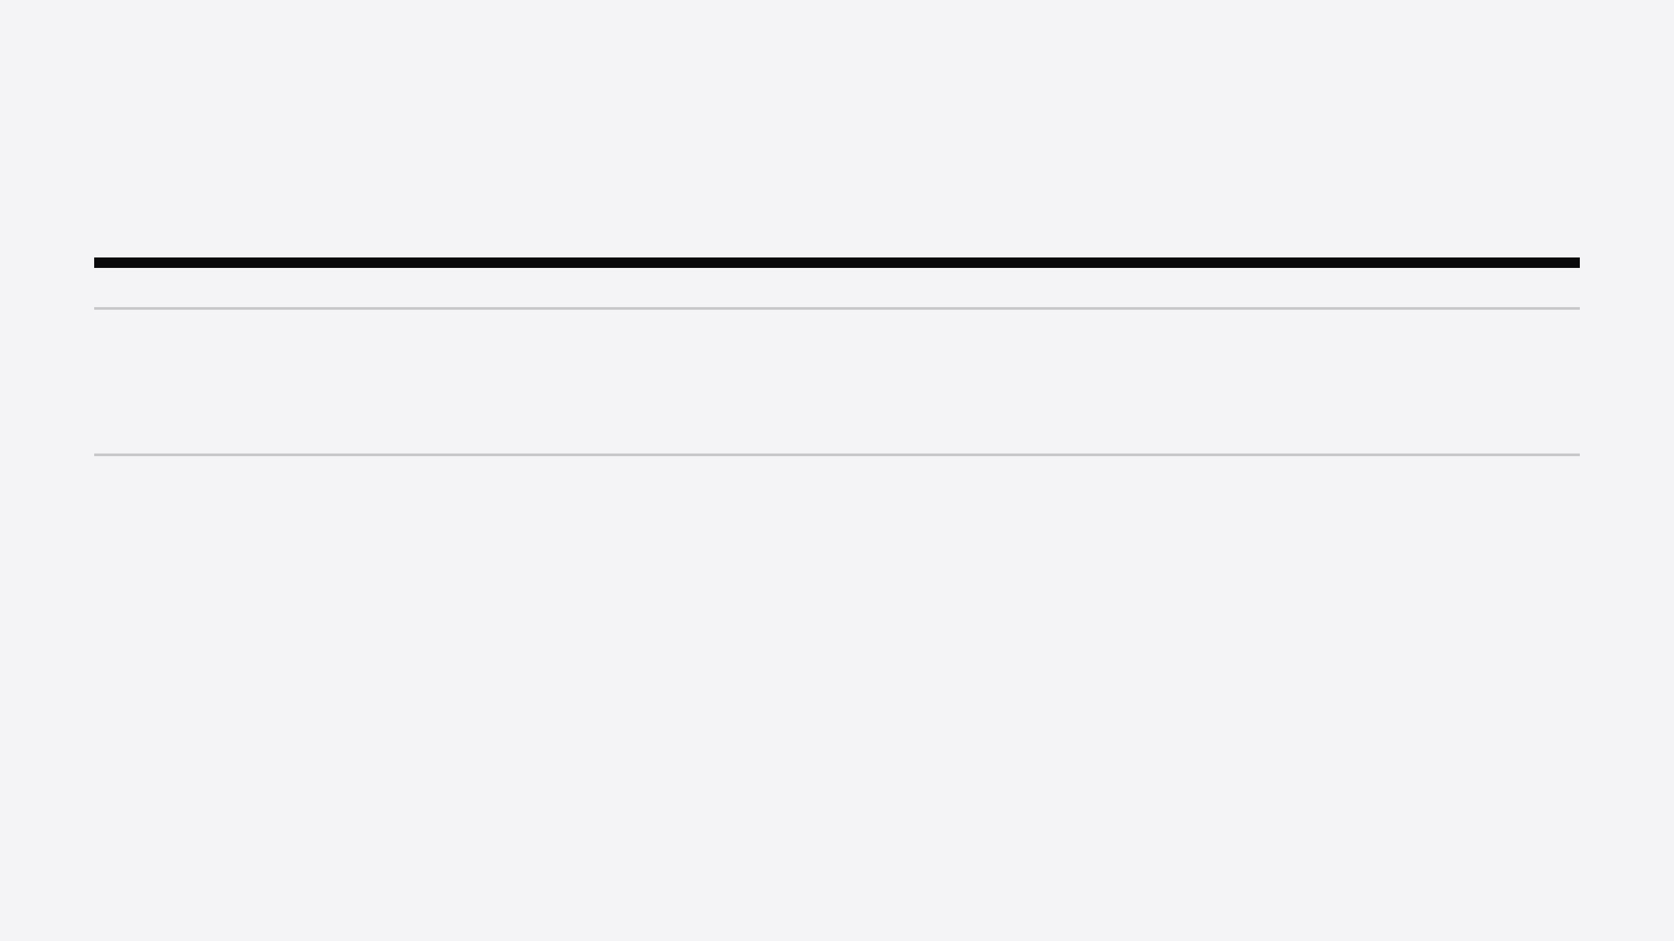
CLIENT Q&A / STRATEGIC FRAMING
The client’s core question is strategic—not technical.
01
If Claude can generate tests, why should a team use ForgeQA?
02
How can a focused platform succeed beside well-developed global products?
03
Can ForgeQA become a sustainable, profitable SaaS business?
04
What creates daily customer value—and what must ship before release?
ForgeQA does not need to be “another AI model.” It needs to become the connected workflow and execution layer for QA teams.
CENTRAL ANSWER

Slide 3
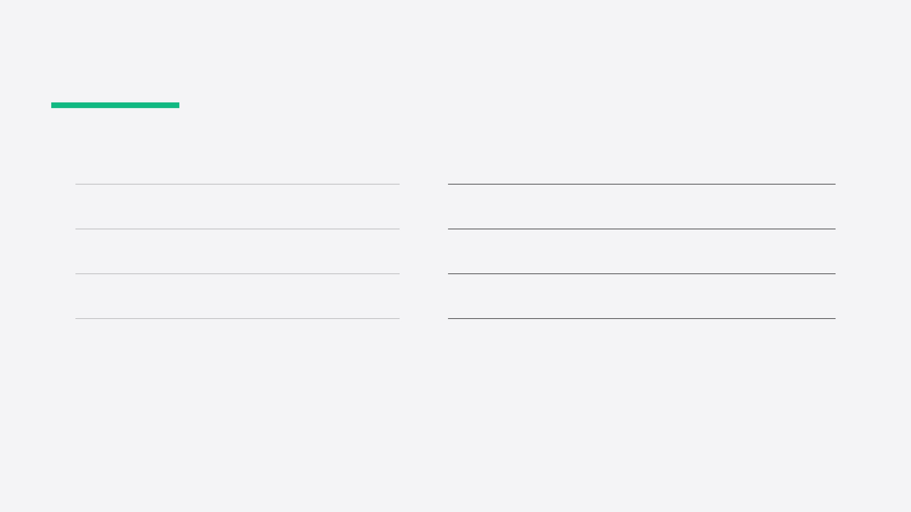
PRODUCT POSITIONING
The moat is the connected workflow.
Generic AI chat
ForgeQA platform
—
Generates text in a single conversation.
+
Stores knowledge, test assets, approvals, and history as durable team records.
—
Needs the user to repeat context, format, and hand-offs.
+
Grounds generation in product documents through the Knowledge Base and RAG.
—
Writes snippets without owning execution or records.
+
Connects test cases to suites, automation scripts, execution, and reports.
—
Leaves teams to connect tools and govern work manually.
+
Supports governance through collaboration, roles, CI/CD integration, and audit history.
ARCHITECTURE CHOICE
Claude, Gemini, and GPT are engines inside ForgeQA—not the product itself.

Slide 4
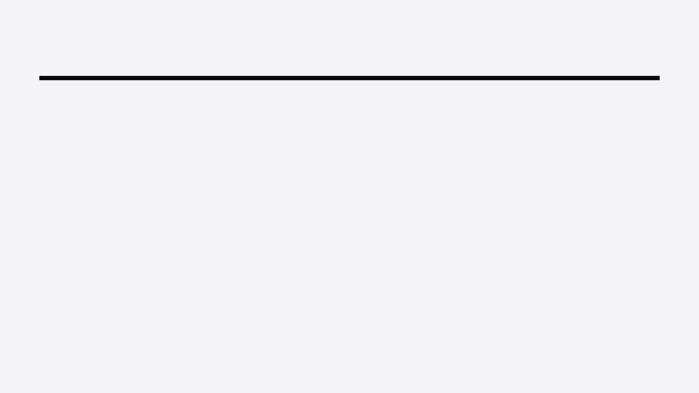
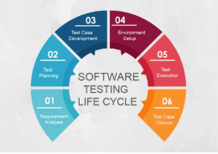
FORGEQA WORKFLOW ARCHITECTURE
The product must connect every hand-off—from initial understanding to governed execution.
One QA operating system.
→
→
→
01 / INPUT
02 / UNDERSTAND
03 / GROUND
04 / GENERATE
Requirements or app URL
PRD & product context
Knowledge Base + RAG
Structured test cases
Structured understanding, not a blank prompt
Story, spec, staging change
Relevant product rules injected
Positive, negative, edge, validation
↓
→
→
→
05 / GOVERN
06 / AUTOMATE
07 / EXECUTE
OUTCOME
Multi-framework scripts
Regression, CI/CD & audit history
A closed QA loop
Review & test suites
From context to evidence—without spreadsheet hand-offs
Per-test results and repeatable release evidence
Status, ownership, reusable records
Playwright, Cypress, Selenium, Puppeteer
LIFECYCLE REFERENCE
PRODUCT IMPLICATION
ForgeQA maps product-specific
The differentiator is not a single model response. It is the durable flow that turns product knowledge into trusted, executable QA work.
work onto a recognizable
software testing lifecycle.

Slide 5

DAILY ADOPTION / CUSTOMER OPERATING RHYTHM
The daily QA productivity loop.
ForgeQA earns repeat usage when it converts every new requirement or staging change into a managed, executable quality workflow.
DAILY TRIGGER
A new Jira story arrives, or a developer shares an updated staging URL.
→
→
→
→
→
01
02
03
04
05
06
Capture
Generate
Review
Organize
Automate
Execute
Paste the story, business rule, or app URL.
Create positive, negative, edge, and validation coverage.
QA verifies cases, steps, expected results, and risk.
Approve cases and add them to a named test suite.
Generate framework-ready scripts from approved tests.
Run regression and retain pass/fail history for the next sprint.
CUSTOMER MESSAGE
“Open ForgeQA with Jira and Slack: begin every feature from a reusable test baseline, then carry it through to real regression evidence.”

Slide 6
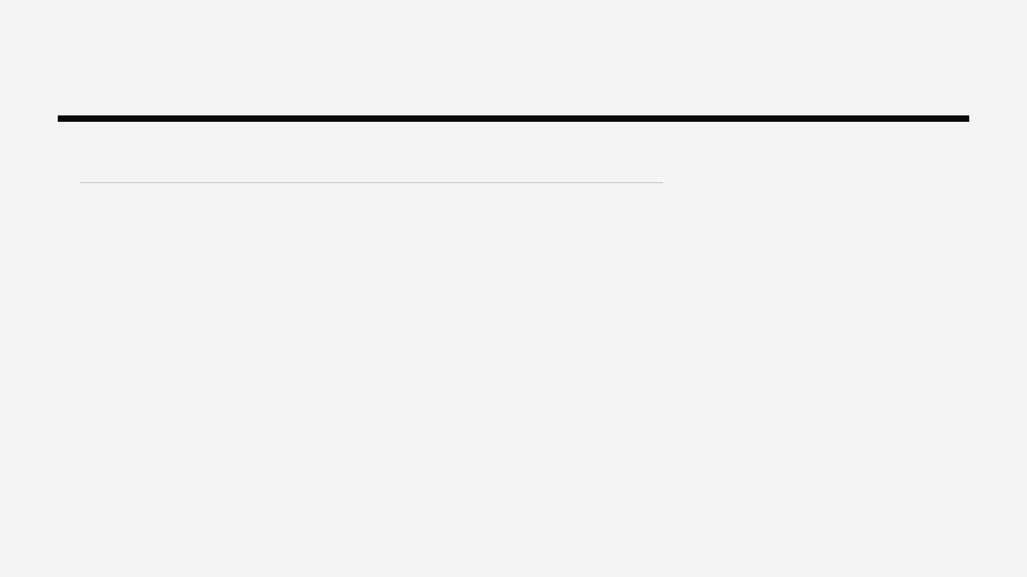
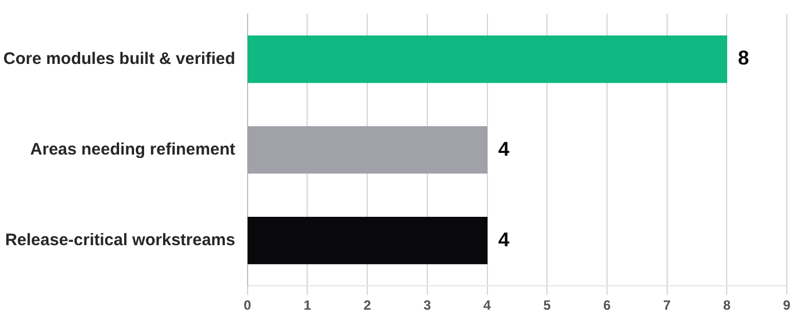
LAUNCH-READINESS AUDIT
Strong foundation; execution gap remains.
Workstreams identified in the client audit
COUNT OF AREAS
RELEASE READOUT
8 / 4 / 4
The base is built. The next release must prove the full workflow.
Prioritize the bridge from product understanding to real test execution: PRD generation, shared workspaces, live runs, and production hardening.
SOURCE & SCOPE
Client-provided ForgeQA launch audit. Built: multi-LLM gateway, generator, RAG, scripts, CI/CD export, security/auth, billing, and suites/history. Refinement: integrations, chunk UX, real execution, selector resilience. Critical: PRD generator, collaboration, live runner, production readiness.

Slide 7
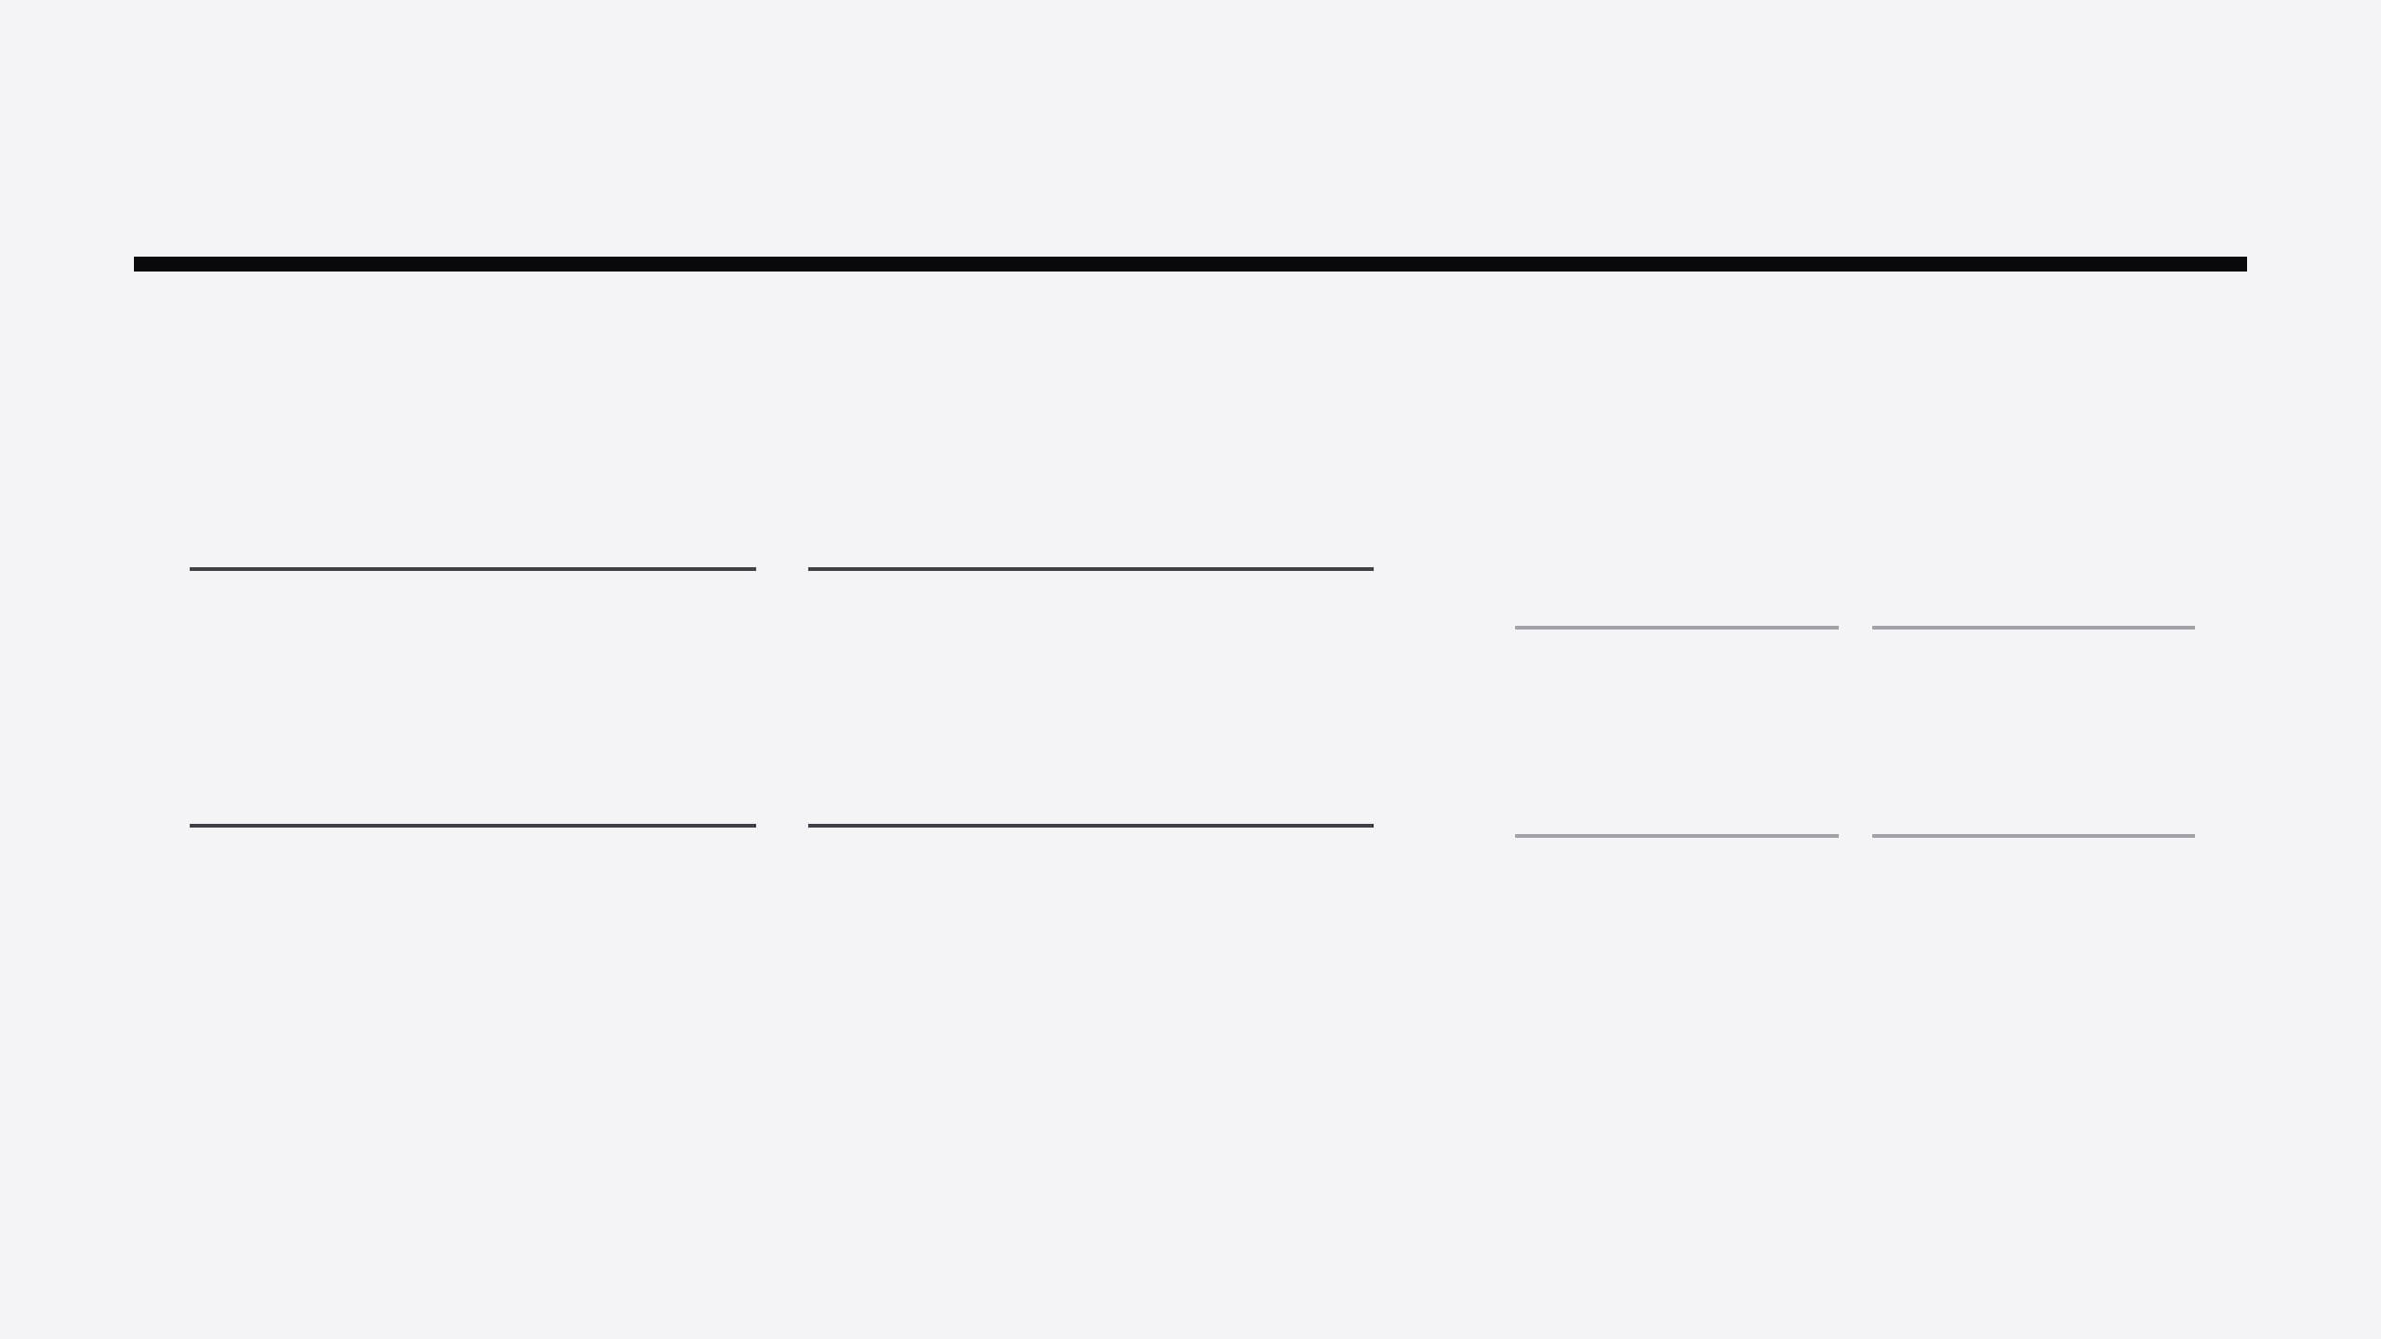
RELEASE ROADMAP / ENGINEERING DECISION
Close the understanding-to-execution gap.
P0 — BUILD BEFORE PUBLIC RELEASE
P1 — UPGRADE AFTER PILOT VALIDATION
Make the full QA workflow real, shareable, and operational.
Remove friction and improve automation resilience.
01
PRD Generator
02
Real Regression Execution
Support text details and URL crawl; export to Markdown, PDF, and DOCX; send approved PRDs to Knowledge Base.
Replace simulated runs with server-side headless execution or remote CI runner with per-test pass/fail results.
A
One-click exports
B
Auto-chunking UX
Connect Jira, TestRail, GitHub.
Chunk on upload with progress.
03
Team Workspaces
04
Production Hardening
C
Self-healing selectors
D
Live runner sandbox
Ship invitations, shared Knowledge Bases and suites, plus role-aware collaboration.
Verify email delivery, Sentry monitoring, database indexes, and required security documentation.
Prefer test IDs, ARIA labels.
Preview script steps in-browser.
RELEASE DECISION
Prioritize proof of the complete workflow over additional feature breadth: understand → generate → approve → execute → report.

Slide 8
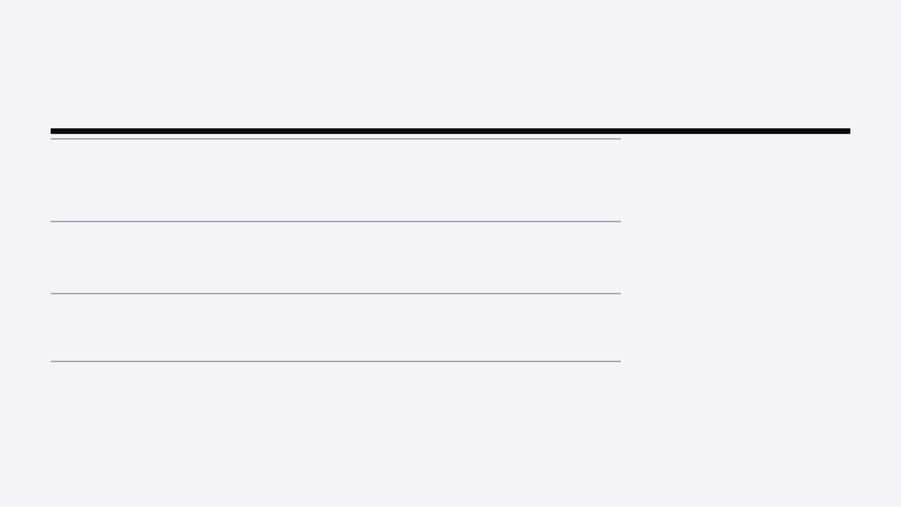
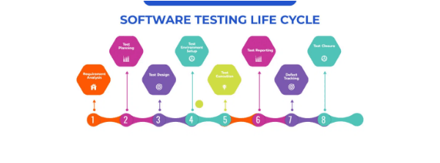
RELEASE VALIDATION / NORTH-STAR WORKFLOW
Validate one critical path first.
The release is credible only when a feature travels continuously from product understanding to a real, governed regression result.
8 STAGES · 4 VALIDATION GATES
GATE 01 UNDERSTAND
→
TESTING LIFECYCLE REFERENCE
01 / INPUT
02 / UNDERSTAND
Story or staging URL
PRD is generated and reviewed
Start with a real feature signal.
Convert source material into usable product context.
GATE 02 GROUND
→
03 / GROUND
04 / GENERATE
ForgeQA should compress the testing lifecycle into one repeatable, team-visible product path.
PRD enters the Knowledge Base
Traceable test matrix
Create structured cases with TC_IDs.
Save and chunk context automatically.
GATE 03 PREPARE
→
05 / APPROVE
06 / AUTOMATE
QA lead assigns a suite
Stable script is generated
Review and organize the release baseline.
Use resilient selectors and chosen framework.
GATE 04 PROVE
→
07 / EXECUTE
08 / INTEGRATE
Real per-test pass/fail run
CI/CD report and audit trail
Eliminate simulated execution.
Share evidence across the delivery team.
A new feature can pass through the entire path without spreadsheet copy-paste or DevOps intervention.
DEFINITION OF DONE

Slide 9
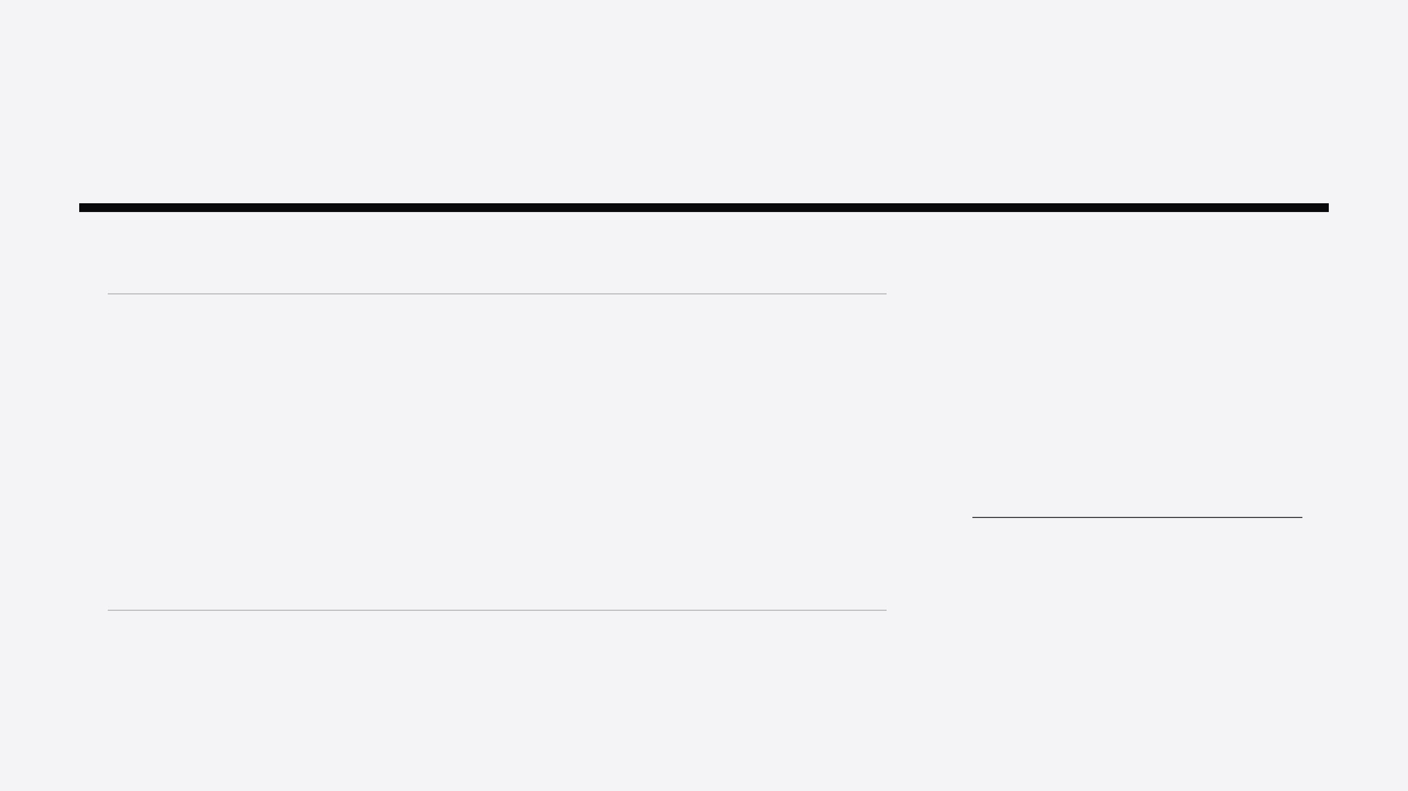
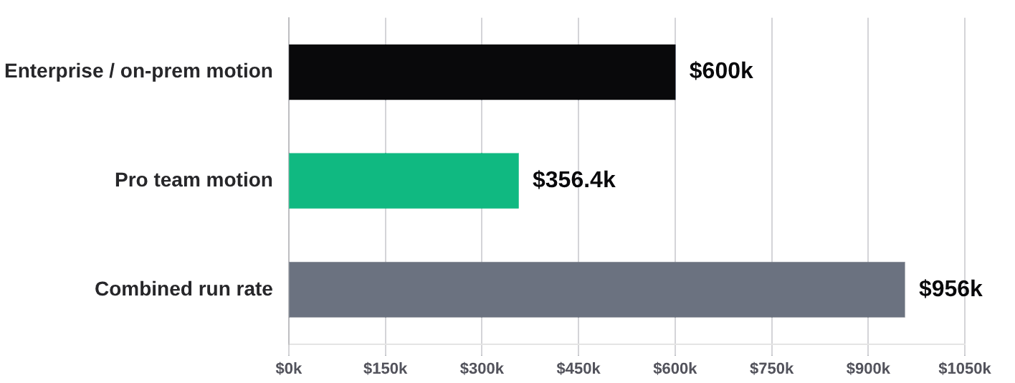
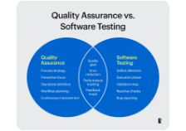
COMMERCIAL MODEL / ILLUSTRATIVE PLANNING CASE
Workflow value creates the business case.
A sustainable business case comes from recurring operational value—not from selling access to a raw model.
Illustrative annual recurring revenue by customer motion
USD · ANNUALIZED
PLANNING READOUT
$956.4k
Annualized run rate from 325 illustrative customers.
A small expansion in customer count, price, or enterprise mix takes this client-brief model beyond $1M ARR.
SaaS-model reference visual. The launch team should validate the business case with pilot conversion, renewal, and gross-margin evidence.
Pro motion: 300 teams × approximately $99/month = $356.4k annualized revenue.
Enterprise motion: 25 teams × approximately $2,000/month = $600k annualized revenue.
IMPORTANT CAVEAT
All figures are illustrative planning assumptions taken from the client-provided ForgeQA business case. Validate willingness to pay, activation, retention, support burden, and actual AI inference costs before treating this as a forecast.

Slide 10
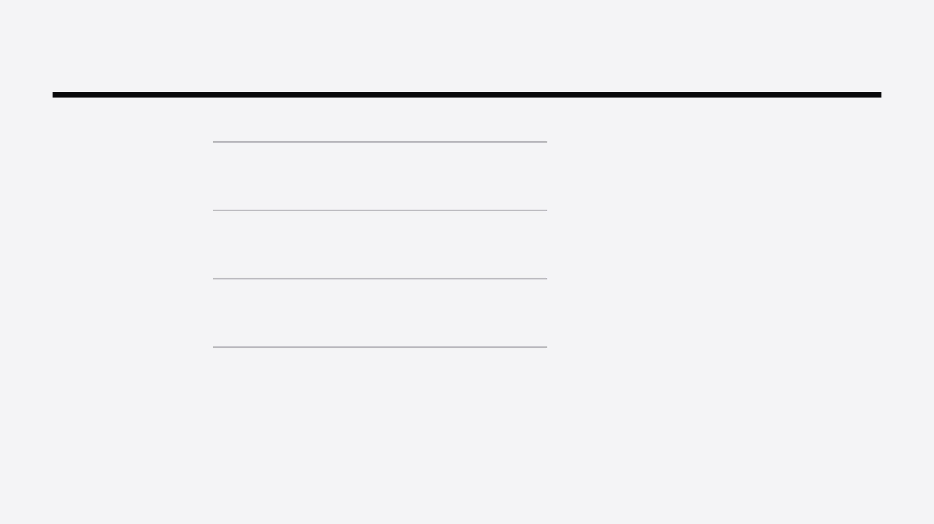
ADOPTION MODEL / CUSTOMER VALUE
Daily adoption expands when each role can see a faster, more governed path through the same QA workflow.
Day-one value for every QA stakeholder.
STAKEHOLDER
DAILY PROMISE
PROOF POINT TO DEMONSTRATE
QA tester
Spend less time formatting test cases and more time exploring product risk.
Turn one user story into 50 structured cases with positive, negative, edge, and validation coverage.
SPEED + COVERAGE
QA lead
Standardize testing quality while keeping a reusable release baseline across the team.
Show review, approval, suite assignment, and persistent history for the same release artifact.
CONSISTENCY + CONTROL
Automation engineer
Start with traceable cases instead of rebuilding intent from spreadsheets and chat output.
Generate framework-ready scripts with stable selector strategies and a visible path to execution.
ACCELERATION + RESILIENCE
Engineering leader
Move releases faster while making quality risk, run status, and ownership visible.
Demonstrate a real regression result, CI/CD trigger, and audit trail from a single feature input.
VELOCITY + EVIDENCE
A senior developer may prefer direct model access. A QA organization needs a shared, repeatable, governed system that works for the whole team on day one.
STRATEGIC BOUNDARY

Slide 11
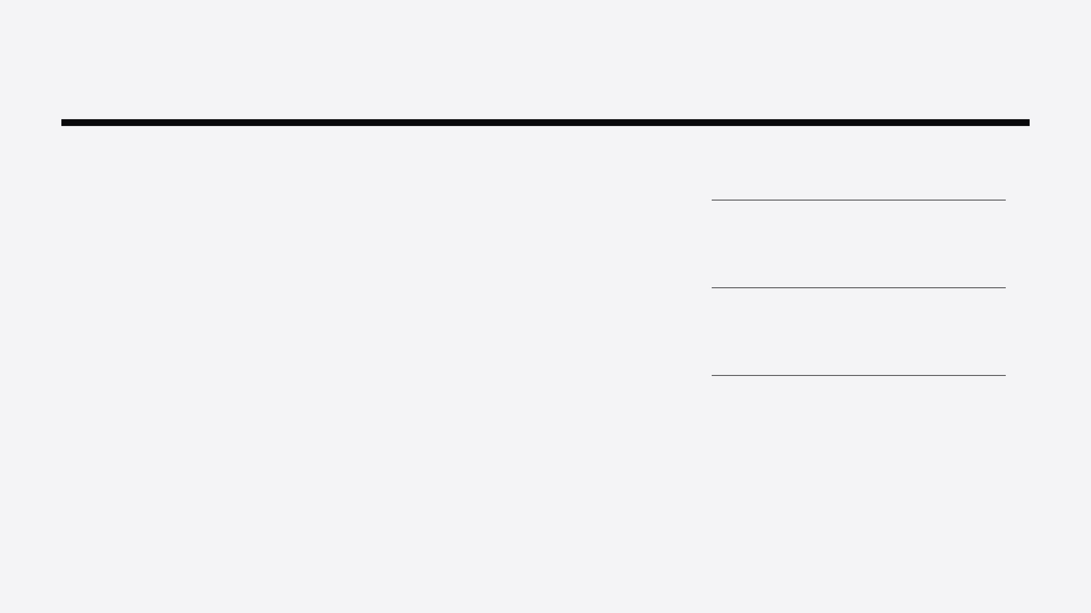
RELEASE-CYCLE AGENDA
Decisions for the next release cycle.
01
AGREE THE NORTH-STAR DEMO
PILOT AND POSITIONING
Staging URL → PRD → Knowledge Base → test suite → real regression result.
04
Run a focused pilot
Start with QA agencies or mid-market teams; validate repeat use, willingness to pay, retention, and cycle-time reduction.
Make this one continuous story the shared acceptance test for product, development, QA, and customer demos.
05
Position honestly
Do not claim a better general-purpose model. Claim a more usable, governed, execution-ready QA workflow.
02
Choose P0 over breadth
03
Instrument the workflow
06
Review one metric weekly
Finish PRD generation, shared workspaces, real execution, and production hardening before expanding the feature catalogue.
Track time-to-first-test, generation-to-approval rate, execution success, export use, and weekly active teams.
Ask whether teams are reaching a real regression result with less setup, fewer hand-offs, and repeatable evidence.
Ship the connected workflow, prove it through real execution, and make it effortless enough to become the QA team’s daily operating layer.
OPERATING PRINCIPLE

Slide 12
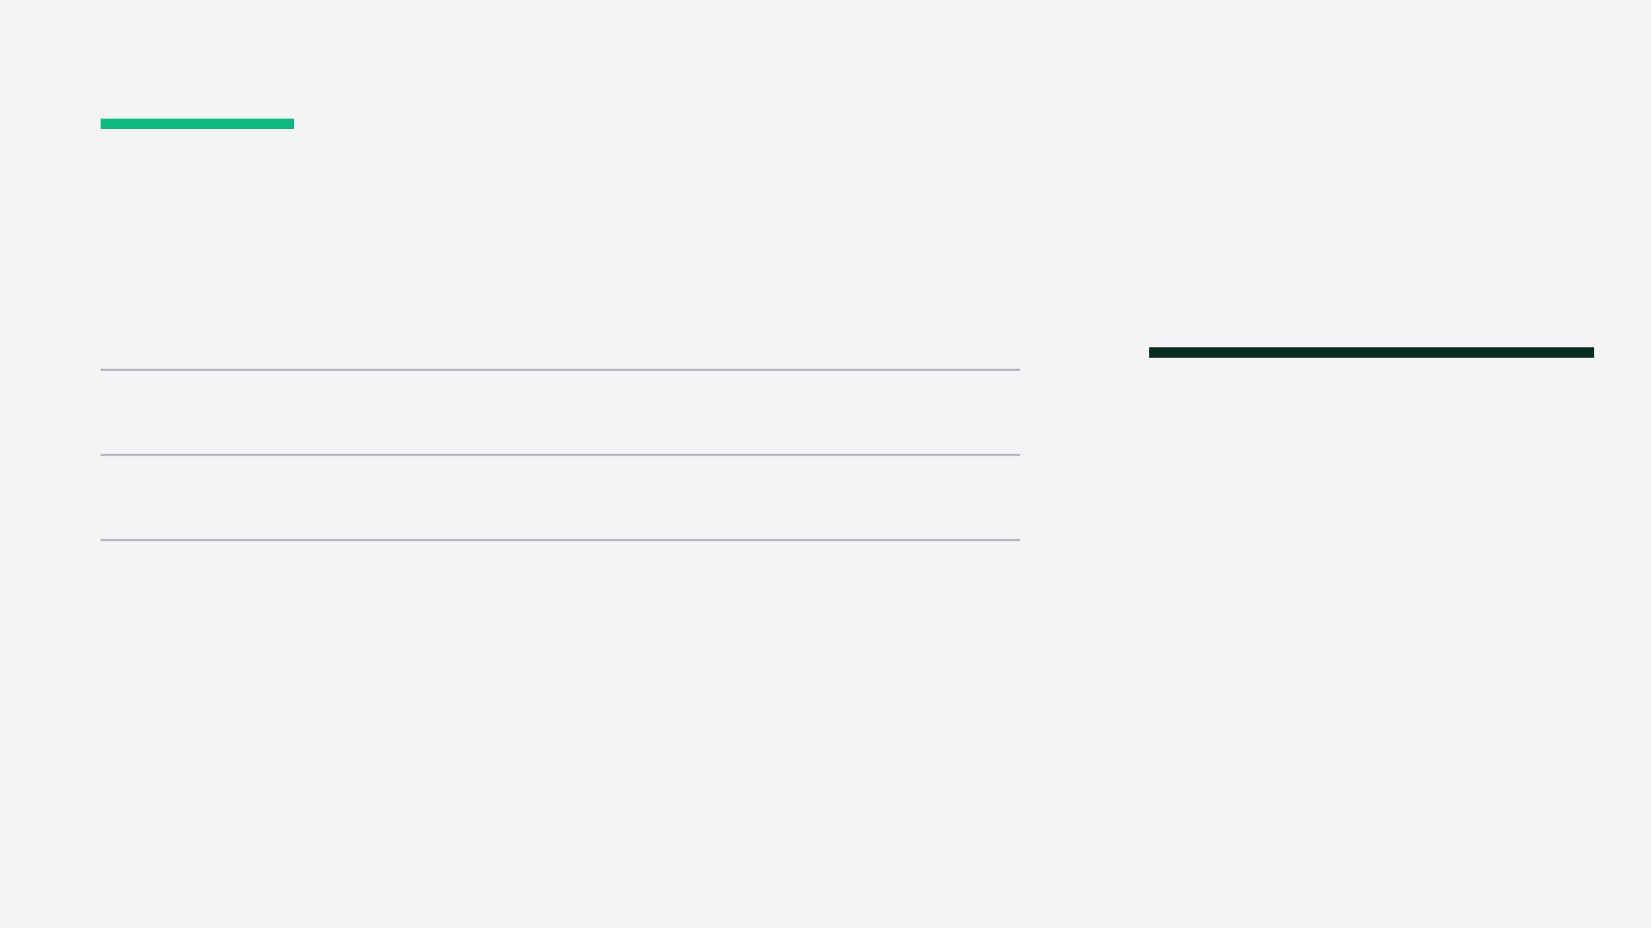
CLOSING / TEAM COMMITMENT
12 / 12
Make ForgeQA the QA execution layer.
01
Ship the connected workflow—not isolated AI features.
RELEASE PRINCIPLE
Build the system—not just the prompt.
02
Prove the promise with real regression execution and evidence.
03
Make daily quality work effortless for the whole team.
The opportunity is a repeatable QA workflow that takes teams from product context to trusted, auditable execution.
ForgeQA Developer + QA Team Working Session | From client questions to release decisions

